Slide 1


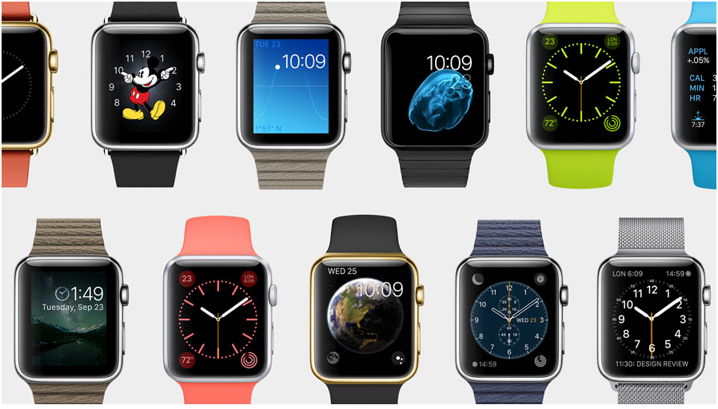
Apple Watch!
The Beauty and Joy of Computing Lecture #3 : Creativity & Abstraction
UC Berkeley EECS Lecturer Gerald Friedland

Slide 2
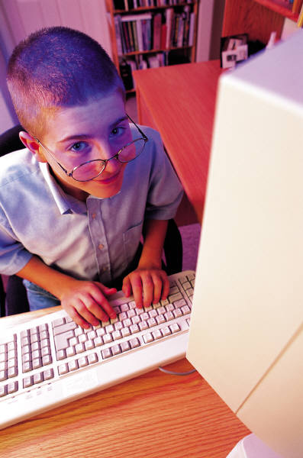
Computing is a Creative Activity
“Creativity and computing are prominent forces in innovation; the innovations enabled by computing have had and will continue to have far-reaching impact.
At the same time, computing facilitates exploration and the creation of knowledge.
This course will emphasize these creative aspects of computing.

Slide 3
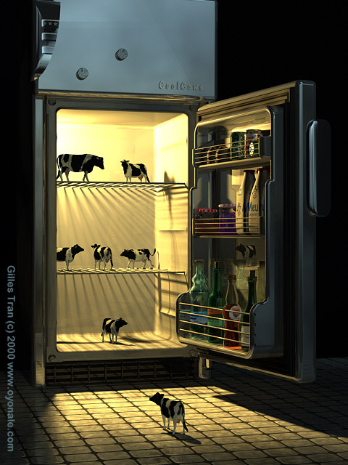
Computing enables people…
…to translate intention into computational artifacts.
A computational artifact is created by human conception using software tools.
Examples of computational artifacts include
digital music, videos, images
documents
combinations of these. E.g.,
infographics
presentations
web pages.

Slide 4
Computing enables people…
…to create digitally!
Creating…
knowledge
tools
expressions of ideas
solutions to problems.
Creating digitally…
requires understanding and using software tools.
can be done by…
combining and modifying existing artifacts
creating new artifacts.

Slide 5
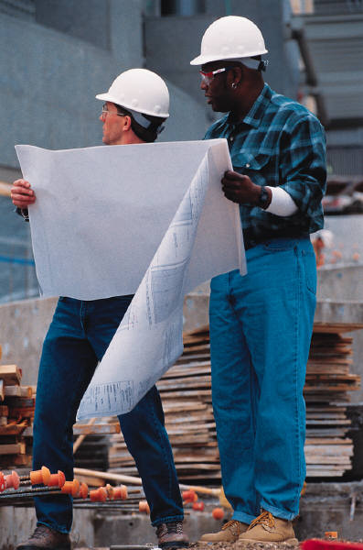
Collaboration is an essential part…
…of creating computational artifacts.
Collaboration facilitates multiple perspectives in developing computational artifacts.
A computational artifact can reflect collaborative intent.

Slide 6
We can analyze computational artifacts…
…for correctness, functionality, and suitability.
A computational artifact may have weaknesses, mistakes, or errors depending on the type of artifact.
For example, music created by a program may not have an error but may simply be hard to listen to.
The functionality and suitability (or appropriateness) of a computational artifact may be related to how it is used or perceived.

Slide 7
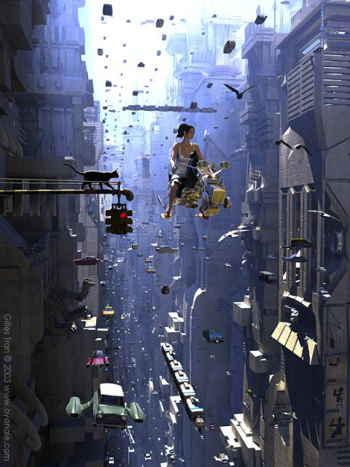
Computing extends traditional forms…
…of human expression and experience.
Computer music can be created by synthesizing sounds, by sampling existing music, or by recording and manipulating sounds.
Creating digital effects, images, and animations has impacted and transformed the movie industry.
Computing enables creative exploration of real and synthetic phenomena.

Slide 8
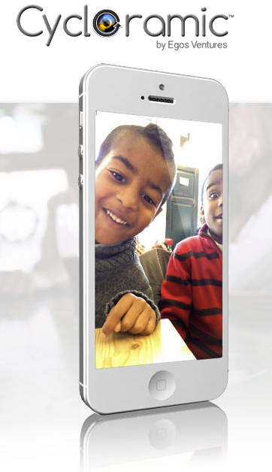
Programs can be developed…
…for creative expression or to satisfy personal curiosity.
A program developed for creative expression or to satisfy personal curiosity may have visual, audible, or tactile results; or the program may affect a computer or system without such results.
Programs developed for creative expression or to satisfy personal curiosity may be developed with different standards or methods than programs developed for widespread distribution.
A program or the results of running a program may be shared with others.

Slide 9

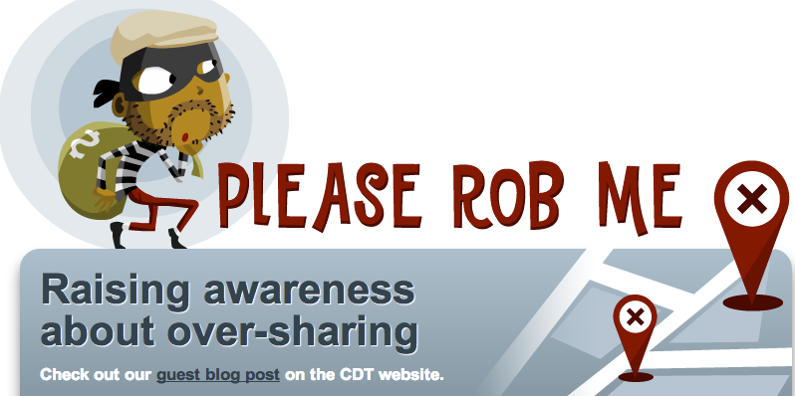
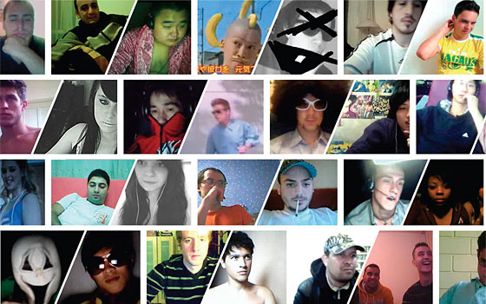
Programs can be developed…
...to solve problems, create new knowledge, or help people, organizations, or society.
however, the goals may be realized independently of the original purpose of the program.
Computer programs and the results of running the programs have widespread impact on individuals, organizations, and society.

Slide 10
Numbers: Positional Notation
Number Base B  B symbols per digit:
Base 10 (Decimal): 0, 1, 2, 3, 4, 5, 6, 7, 8, 9
Base 2 (Binary): 0, 1 (In binary digits are called “bits”)
Base 16 (Hexadecimal): 0, 1, 2, 3, 4, 5, 6, 7, 8, 9, A, B, C, D, E, F
Number representation:
d₃₁d₃₀ ... d₁d₀ is a 32 digit number
value = d₃₁ × B³¹ + d₃₀ × B³⁰ + ... + d₁ × B¹ + d₀ × B⁰
Binary 0b11010 = 1×2⁴ + 1×2³ + 0×2² + 1×2¹ + 0×2⁰ = 16 + 8 + 2 = 26
Hex 0x1A = 1×16¹ + 10×16⁰ = 16 + 10 = 26
One hex digit (four bits) is a “nibble”. Two (eight bits) is a “byte” (values 0-255)
N bits  at most 2^{N} things

Slide 11
Abstraction (revisited): Numbers
Number bases, including binary and decimal, are used for reasoning about digital data.
Bits represent binary data using base two digits: zero and one.
Hexadecimal, or base-16, is often used in reasoning about data such as colors in images.
Different bases help in reasoning about digital data; digital data is stored in bits.

Slide 12
Abstraction (revisited): Digital Data
A combination of abstractions is used to represent digital data.
At the lowest level all digital data are represented by bits.
Said another way, bits can represent anything!
Bits are grouped to represent higher-level abstractions including numbers and characters.
Logical values? 0 → False, 1 → True
Colors? 00 → Red, 01 → Green, 10 → Blue
Characters? 00000 → ‘a’, 00001 → ‘b’, …
Higher-level abstractions such as Internet protocol (IP) packets, images, and audio files are comprised of groups of bits that represent different parts of the abstractions.

Slide 13
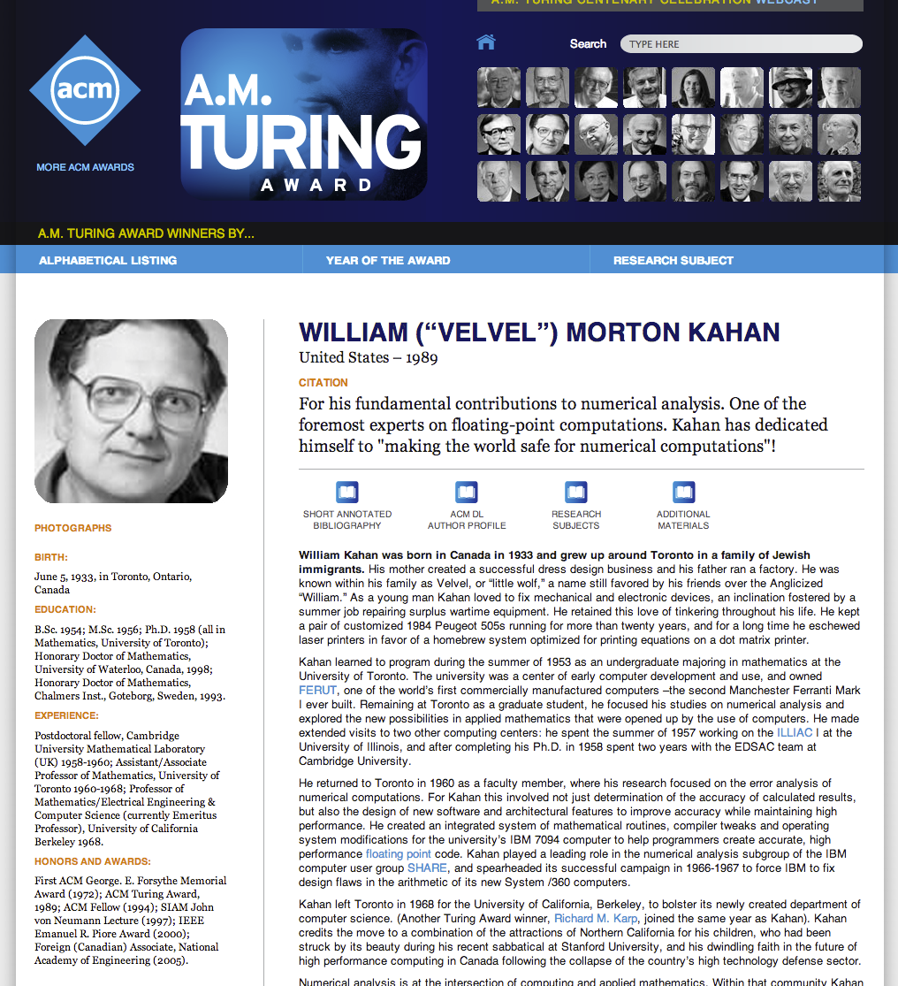
Binary Sequences to Represent Data
A finite representation is used to model the infinite mathematical concept of a number.
In many programming languages the fixed number of bits used to represent integers limits the range of integer values, and mathematical operations can result in overflow or other errors.
In many programming languages the fixed number of bits used to represent real numbers (represented as “floating-point numbers”) limits their range, and mathematical operations can result in round-off and other errors.

Slide 14
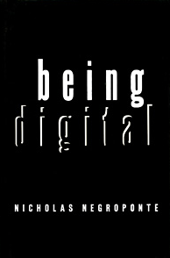
Interpretation of a Binary Sequence…
…depends on how it is used (e.g., as instruction, number, text, sound, or image).
The sequence of bits that represents…
…an instruction may also represent data processed by that instruction.
…a character/letter may also represent a number.
…a color in an image may also represent a sound in an audio file.

Slide 15
SW and HW built on multiple abstractions!
Software is built using low- and high-level abstractions…
such as expressions, statements, data types, functions, and libraries.
that represent hardware, such as device drivers and game controllers.
Hardware is built using low- and high-level abstractions such as chips, memory, and storage.

Slide 16

Binary Data is processed by…
…physical layers of computing hardware, including gates, chips, and components.
A logic gate is a hardware abstraction that models a Boolean function.
A chip is an abstraction composed of low-level components and circuits that performs a specific function such as memory, CPU, encryption, and more.
A hardware component can be low level like a transistor or high level like a video card.

Slide 17
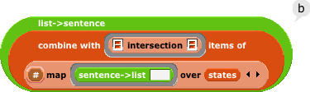
Programming languages, from low to high level…
…are used in developing software.
Low-level programming languages, such as assembly, are closer to the machine level and provide fewer abstractions for the programmer.
High-level programming languages provide more abstractions for the programmer and are easier for humans to use for reading and writing code.
Code in a high-level programming language is typically automatically translated into code in a lower-level language to be executed on a computer; this is done by a compiler or an interpreter.
solve(x,y)
add $v0 $t1 3
0 1 0 1 1 0

Slide 18

Abstractions everywhere!
Applications and systems are designed, developed, and analyzed using levels of hardware, software, and conceptual abstractions.
E.g., Mobile applications and systems
E.g,. Web services (both an application and a system)

Slide 19
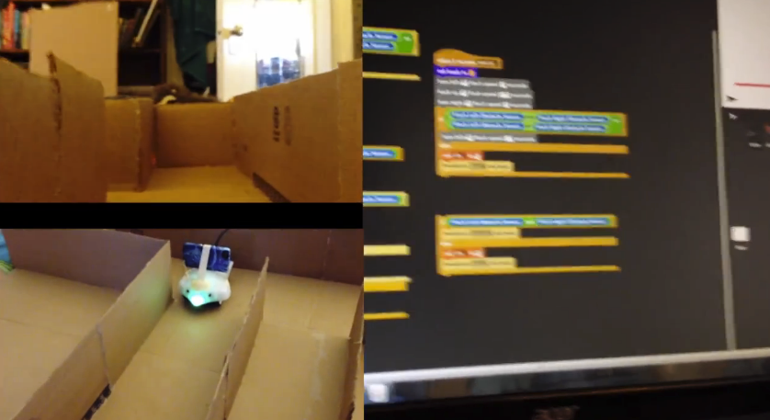
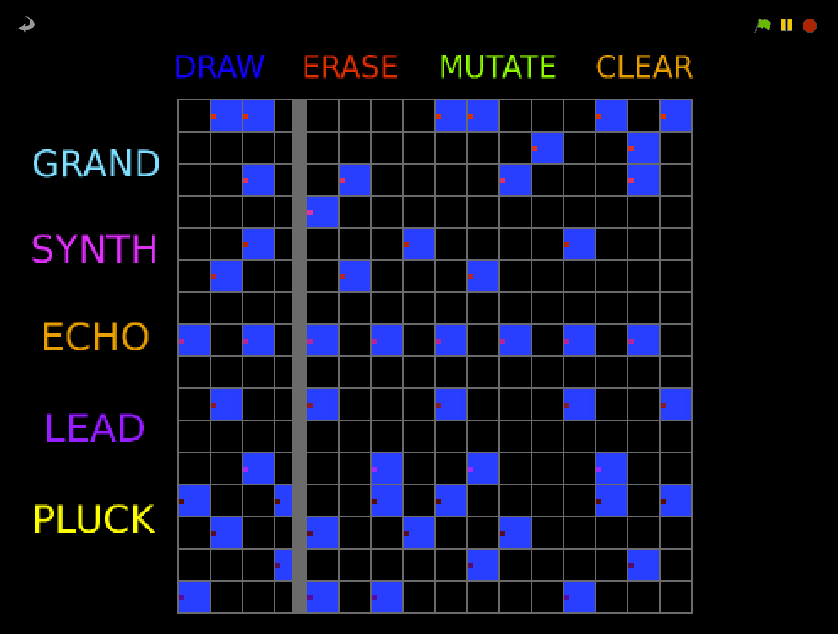
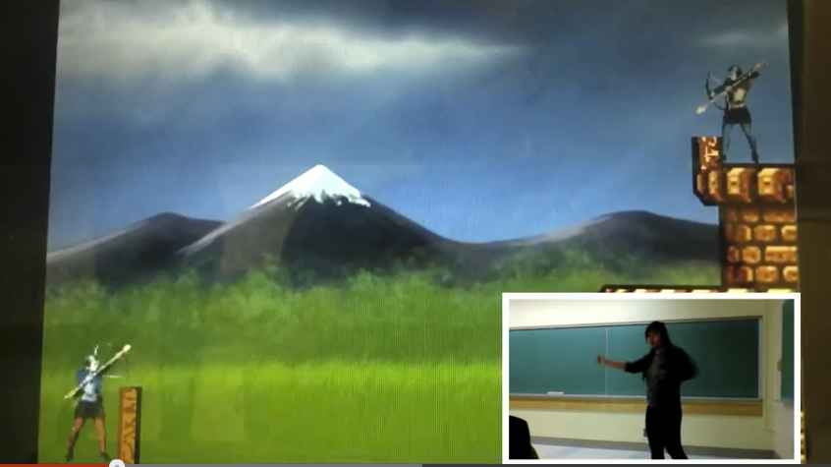
Summary
Creativity
You will create interesting and relevant artifacts with the tools and techniques of computer science.
Abstraction
This course will include examples of abstractions used in modeling the world, managing complexity, and communicating with people as well as with machines.
You will learn to work with multiple levels of abstraction while engaging with computational problems and systems.

